Slide 1

HTML Advanced: HTML 5

Slide 2
HTML5: What is it?
HTML5 will be the new standard for HTML, XHTML, and the HTML DOM (document object model).
The previous version of HTML came in 1999. The web has changed a lot since then.
HTML5 is still a work in progress, but most modern browsers have some HTML5 support.

Slide 3
HTML5: Origins
HTML5 is a cooperation between the World Wide Web Consortium (W3C) and the Web Hypertext Application Technology Working Group (WHATWG).
WHATWG was working with web forms and applications, and W3C was working with XHTML 2.0. In 2006, they decided to cooperate and create a new version of HTML.

Slide 4
HTML5: Ground Rules
Some rules for HTML5 were established:
> New features should be based on HTML,
CSS, DOM, and JavaScript
> Reduce the need for external plugins
> Better error handling
> More markup to replace scripting
> HTML5 should be device independent
> Dev process should be visible to the public

Slide 5
HTML5: New Features
> Canvas element for drawing
> Video/audio elements for media playback
> Better support for local offline storage
> New content specific elements, like article,
footer, header, nav, section
> New form controls, like calendar, date, time,
email, url, search

Slide 6
HTML5: Support
HTML5 is not yet an official standard, and no browser has full HTML5 support.
Darn it.

Slide 7
HTML5: Support
You may well ask: “How can I start using HTML5 if older browsers don’t support it?” But the question itself is misleading.
HTML5 is not one big thing; it is a collection of individual features. You can only detect support for individual features, like canvas, video, or geolocation.

Slide 8
HTML5: Support
Love it or hate it, you can’t deny that HTML 4 is the most successful markup format ever. HTML5 builds on that success.
You don’t need to throw away your existing markup. You don’t need to relearn things you already know. If your web application worked yesterday in HTML 4, it will still work today in HTML5. Period.

Slide 9
HTML5: Example
HTML5 supports all the form controls from HTML 4, but it also includes new input controls. Some of these are long-overdue additions like sliders and date pickers; others are more subtle...

Slide 10
HTML5: Example
For example, the email input type looks just like a text box, but mobile browsers will customize their onscreen keyboard to make it easier to type email addresses. Older browsers that don’t support the email input type will treat it as a regular text field, and the form still works with no markup changes or scripting hacks.

Slide 11
HTML5: DOCTYPE
The DOCTYPE which comes before the beginning <html> tag is much simpler in HTML 5. Here are some examples of what it looks like now...
<!DOCTYPE HTML PUBLIC "-//W3C//DTD HTML 4.01//EN" "http://www.w3.org/TR/html4/strict.dtd">
<!DOCTYPE HTML PUBLIC "-//W3C//DTD HTML 4.01 Transitional//EN" "http://www.w3.org/TR/html4/loose.dtd">
<!DOCTYPE html PUBLIC "-//W3C//DTD XHTML 1.1//EN" "http://www.w3.org/TR/xhtml11/DTD/xhtml11.dtd">

Slide 12
HTML: DOCTYPE
Previous versions of HTML defined a lot of doctypes, and choosing the right one could be tricky. In HTML5, there is only one doctype:
<!DOCTYPE html>

Slide 13
HTML: Support
Whether you want to draw on a canvas, play video, design better forms, or build web applications that work offline, you’ll find that HTML5 is already well-supported.

Slide 14
HTML: Support
Firefox, Safari, Chrome, Opera, and mobile browsers already support canvas, video, geolocation, local storage, and more. Google already supports microdata annotations. Even Microsoft — rarely known for blazing the trail of standards support — will be supporting most HTML5 features in the upcoming Internet Explorer 9.

Slide 15
HTML5: MIME types
Every time your web browser requests a page, the web server sends “headers” before it sends the actual page markup. Headers are important, because they tell your browser how to interpret the page markup that follows.
MIME = Multipurpose Internet Mail Extensions

Slide 16

HTML5: MIME types
The most important header is called Content-Type, and it looks like this:
Content-Type: text/html
“text/html” is called the “content type” or “MIME type” of the page.

Slide 17
HTML5: MIME types
This header is the only thing that determines what a particular resource truly is, and therefore how it should be rendered. Images have their own MIME types (image/jpeg for JPEG images, image/png for PNG images, and so on). JavaScript files have their own MIME type. CSS stylesheets have their own MIME type. Everything has its own MIME type. The web runs on MIME types.

Slide 18
HTML5: Detection
When your browser renders a web page, it constructs a Document Object Model, a collection of objects that represent the HTML elements on the page. Every element is represented in the DOM by a different object.
In browsers that support HTML5 features, certain objects will have unique properties. A quick peek at the DOM will tell you which features are supported.

Slide 19
HTML5: Detection
[Modernizr] is an open source, MIT-licensed JavaScript library that detects support for many HTML5 & CSS3 features. To use it, include the following <script> element at the top of your page...

Slide 20
HTML5: Detection
<!DOCTYPE html>
<html>
<head>
<meta charset="utf-8">
<title>HTML5 sure is fun</title>
<script src="modernizr.min.js"></script>
</head>
<body>
...
</body>
</html>

Slide 21
HTML5: Detection
Modernizr runs automatically. When it runs, it creates a global object called Modernizr, that contains a set of Boolean properties for each feature it can detect. For example, if your browser supports the canvas API, the Modernizr.canvas property will be true – otherwise the property will be false.

Slide 22
HTML5: Detection
if (Modernizr.canvas) {
// let's draw some shapes!
} else {
// no native canvas support available :(
}
More on HTML5 detection (and Modernizr) here: http://diveintohtml5.org/detect.html

Slide 23
HTML5: What's New
The internet has changed a lot since HTML 4.01 became a standard in 1999.
Today, some elements in HTML 4.01 are obsolete, never used, or not used the way they were intended to be. These elements are deleted or re-written in HTML5.
HTML5 also includes new elements for better structure, drawing, media content, form handling.

Slide 24
HTML5: What's New
New elements list: http://www.w3schools.com/html5/
Some of the new markup elements are handy for creating better page structure. See the next slide for a representation of some of these elements.

Slide 25
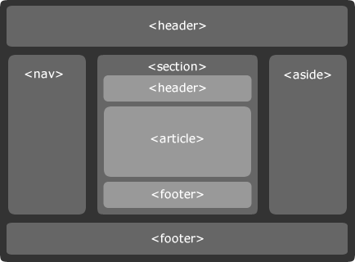
HTML5: What's New

Slide 26
HTML5: Video
Until now, there hasn't been a standard for showing video on a web page.
Today, most videos are shown through a plugin (like Flash). However, not all browsers have the same plugins.
HTML5 specifies a standard way to include video with the video element.

Slide 27
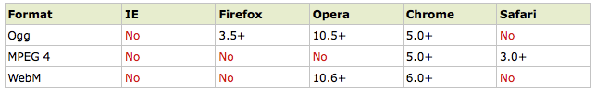
HTML5: Video
Currently, there are 3 supported video formats for the video element:

Slide 28
HTML5: Video
<!DOCTYPE HTML>
<html>
<body>
<video src="movie.ogg" width="320" height="240" controls="controls">
Your browser does not support the video tag.
</video>
</body>
</html>

Slide 29
HTML5: Video
The last example uses an Ogg file, and will work in Firefox, Opera and Chrome.
To make the video work in Safari and future versions of Chrome, we must add an MPEG4 and WebM file.
The video element allows multiple source elements. Source elements can link to different video files. The browser will use the first recognized format:

Slide 30
HTML5: Video
<video width="320" height="240" controls="controls">
<source src="movie.ogg" type="video/ogg" />
<source src="movie.mp4" type="video/mp4" />
<source src="movie.webm" type="video/webm" />
Your browser does not support the video tag.
</video>

Slide 31
HTML5: Video
<sarcasm>Surprising fact...</sarcasm>
Internet Explorer 8 does not support the video element. In IE 9, there will be support for video element using MPEG4.

Slide 32
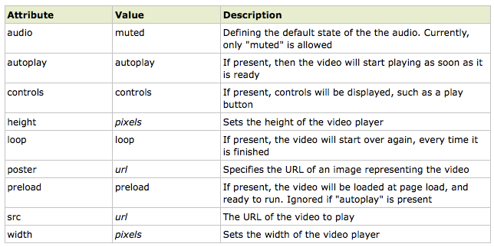
HTML5: Video

Slide 33
HTML5: Audio
Until now, there has never been a standard for playing audio on a web page.
Today, most audio is played through a plugin (like Flash). However, not all browsers have the same plugins.
HTML5 specifies a standard way to include audio, with the audio element. The audio element can play sound files, or an audio stream.

Slide 34
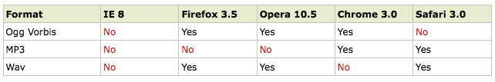
HTML5: Audio
Currently, there are 3 supported formats for the audio element:

Slide 35
HTML5: Audio
<!DOCTYPE HTML>
<html>
<body>
<audio src="song.ogg" controls="controls">
Your browser does not support the audio element.
</audio>
</body>
</html>

Slide 36
HTML5: Audio
The last example uses an Ogg file, and will work in Firefox, Opera and Chrome.
To make the audio work in Safari, the audio file must be of type MP3 or Wav.
The audio element allows multiple source elements. Source elements can link to different audio files. The browser will use the first recognized format.

Slide 37
HTML5: Audio
<audio controls="controls">
<source src="song.ogg" type="audio/ogg" />
<source src="song.mp3" type="audio/mpeg" />
Your browser does not support the audio element.
</audio>

Slide 38
HTML5: Audio
Another fact: Internet Explorer 8 does not support the audio element. In IE 9, there will be support for audio element.

Slide 39
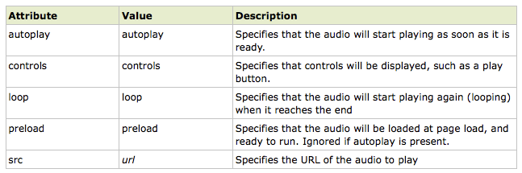
HTML5: Audio

Slide 40
HTML5: Canvas
The HTML5 canvas element uses JavaScript to draw graphics on a web page.
A canvas is a rectangular area, and you control every pixel of it.
The canvas element has several methods for drawing paths, boxes, circles, characters, and adding images.

Slide 41
HTML5: Canvas
Adding a canvas element to the HTML5 page.
Specify the id, width, height of the element:
<canvas id="myCanvas" width="200" height="100"></canvas>

Slide 42
HTML5: Canvas
The canvas element has no drawing abilities of its own. All drawing must be done inside a JavaScript:
<script type="text/javascript">
var c=document.getElementById("myCanvas");
var cxt=c.getContext("2d");
cxt.fillStyle="#FF0000";
cxt.fillRect(0,0,150,75);
</script>
Visit the sandbox >>

Slide 43
HTML5: Web Storage
For information about web storage:
http://www.w3schools.com/html5/

Slide 44
HTML5: Input types
HTML5 has several new input types for forms.
> email
> url
> number
> range
> date pickers (date, month, week, time,
datetime, datetime-local)‏
> search
> color

Slide 45
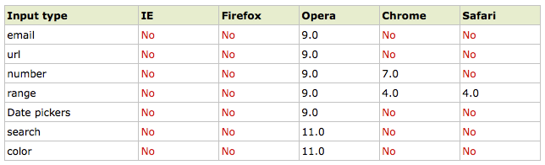
HTML5: Input types
Note: Opera has the best support for the new input types. However, you can already start using them in all major browsers. If they are not supported, they will behave as regular text fields.

Slide 46
HTML5: Input - e-mail
The email type is used for input fields that should contain an e-mail address.
The value of the email field is automatically validated when the form is submitted.
E-mail: <input type="email" name="user_email" />
Tip: Safari on the iPhone recognizes the email input type, and changes the on-screen keyboard to match it (adds @ and .com options).

Slide 47
HTML5: Input - url
The url type is used for input fields that should contain a URL address.
The value of the url field is automatically validated when the form is submitted.
Homepage: <input type="url" name="user_url" />
Tip: Safari on the iPhone recognizes the url input type, and changes the on-screen keyboard to match it (adds .com option).

Slide 48
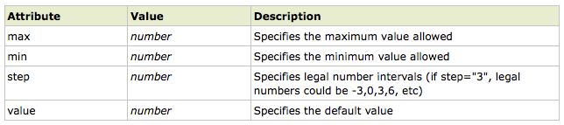
HTML5: Input - number
The number type is used for input fields that should contain a numeric value.
Set restrictions on what numbers are accepted:
Points: <input type="number" name="points" min="1" max="10" />

Slide 49
HTML5: Input - range
The range type is used for input fields that should contain a value from a range of numbers.
The range type is displayed as a slider bar.
You can also set restrictions on what numbers are accepted:
<input type="range" name="points" min="1" max="10" />

Slide 50
HTML5: Input – date pickers
HTML5 has several new input types for selecting date and time:
> date - Selects date, month and year
> month - Selects month and year
> week - Selects week and year
> time - Selects time (hour and minute)‏
> datetime - Selects time, date, month and year
> datetime-local - Selects time, date, month and
year (local time)‏

Slide 51
HTML5: Input - search
The search type is used for search fields like a site search or Google search.
The search field behaves like a regular text field.

Slide 52
HTML5: Input – color picker
The color type is used for input fields that should contain a color.
This input type will allow you to select a color from a color picker:
Color: <input type="color" name="user_color" />

Slide 53
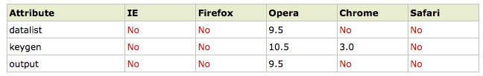
HTML5: Input - form
HTML5 has several new elements and attributes for forms.
> datalist
> keygen
> output

Slide 54
HTML5: Form elements
The datalist element specifies a list of options for an input field. The list is created with option elements inside the datalist.
The purpose of the keygen element is to provide a secure way to authenticate users.
The output element is used for different types of output, like calculations or script output:

Slide 55
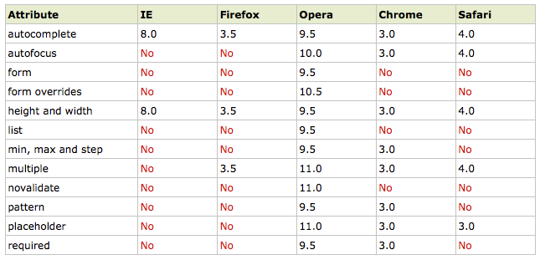
HTML5: Form attributes

Slide 56
HTML5: Reference
For a decent list of references:
http://www.w3schools.com/html5

Slide 57

End of Workshop
More web workshops can be found at
www.tinyurl.com/rpi123

